Slide 1
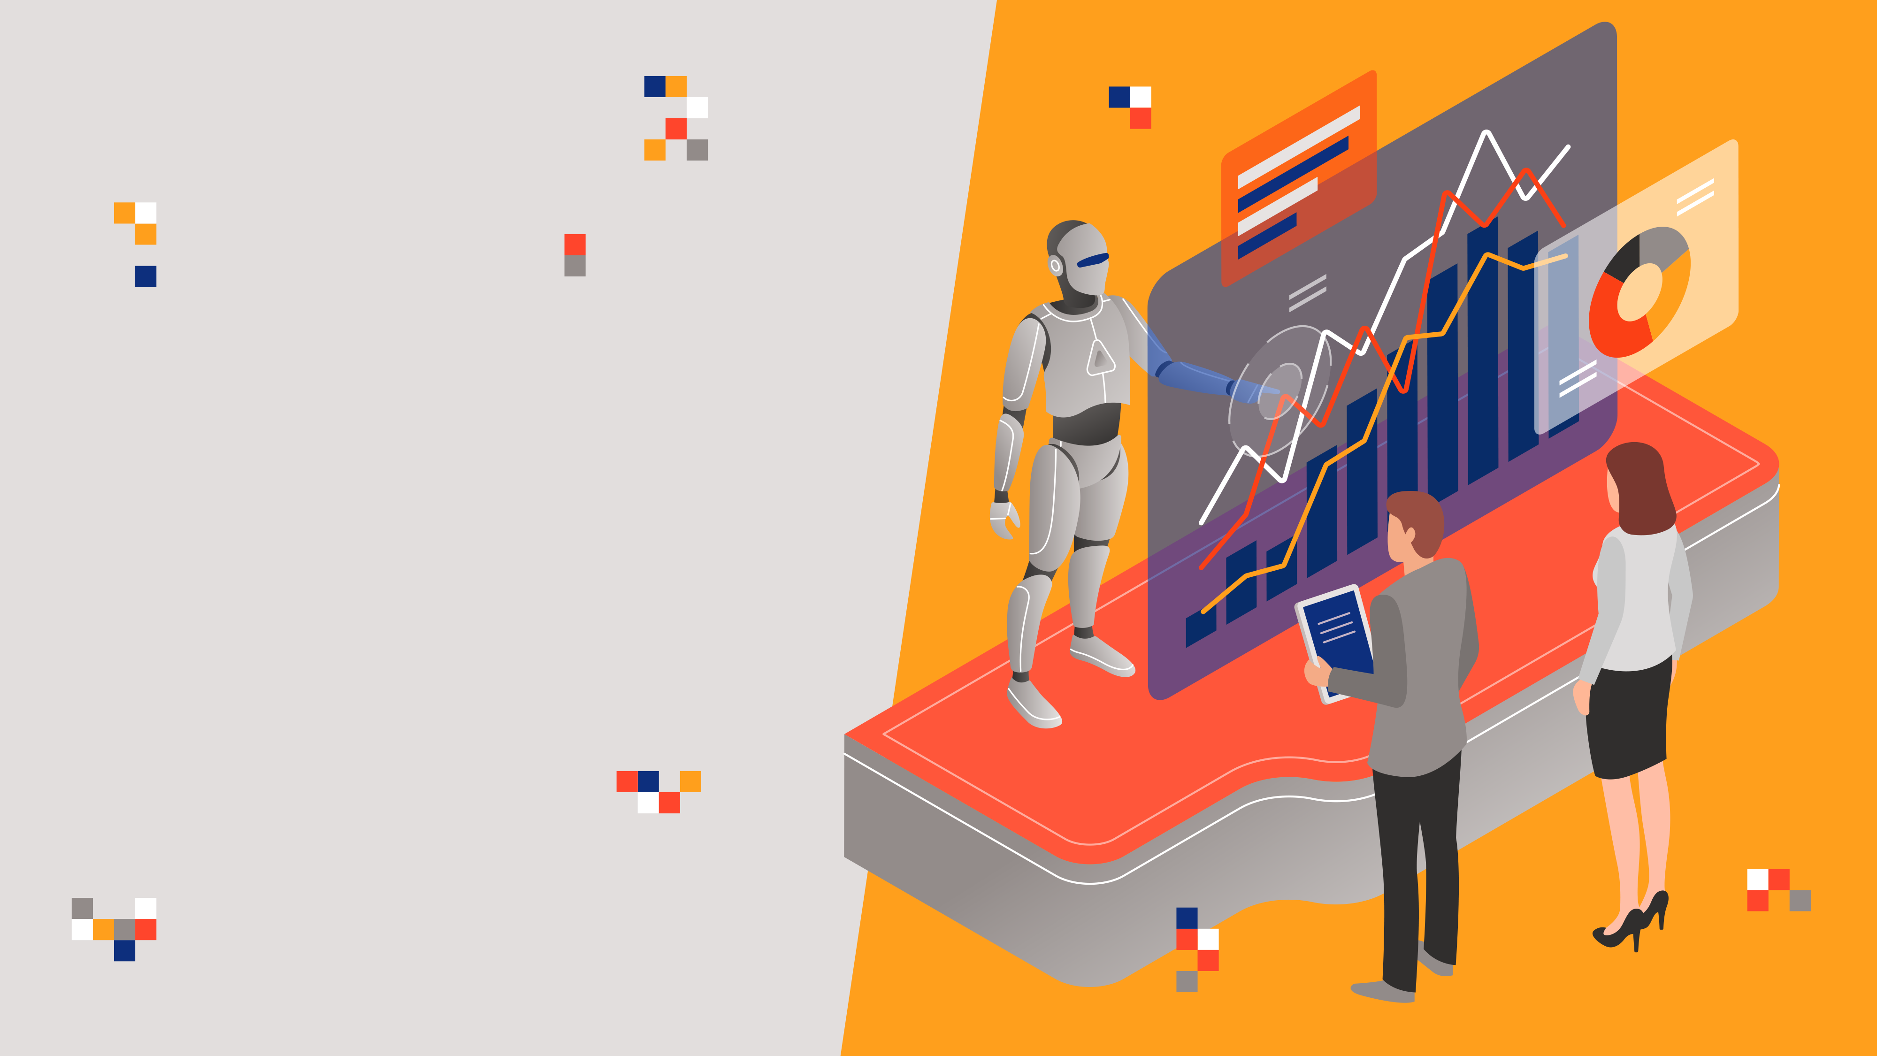
Data Science
for Business

Slide 2

Hiring and retaining employees are extremely complex tasks that require capital, time and skills.
“Small business owners spend 40% of their working hours on tasks that do not generate any income such as hiring”.
“Companies spend 15%-20% of the employee's salary to recruit a new candidate”.
Source: https://toggl.com/blog/cost-of-hiring-an-employee

Slide 3
“An average company loses anywhere between 1% and 2.5% of their total revenue on the time it takes to bring a new hire up to speed”.
Hiring a new employee costs an average of $7645 (0-500 corporation).
It takes 52 days on average to fill a position.
Source: https://toggl.com/blog/cost-of-hiring-an-employee

Slide 4
You work as a data scientist at a multinational corporation.
The HR team collected extensive data on their employees and approached you to develop a model that could predict which employees are more likely to quit.
The team provided you with an extensive data, here's a sample of the dataset:
JobInvolvement
Education
JobSatisfaction
PerformanceRating
RelationshipSatisfaction
WorkLifeBalance
Data Source: https://www.kaggle.com/pavansubhasht/ibm-hr-analytics-attrition-dataset

Slide 5
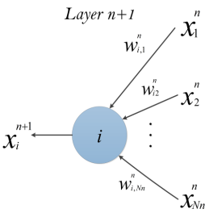
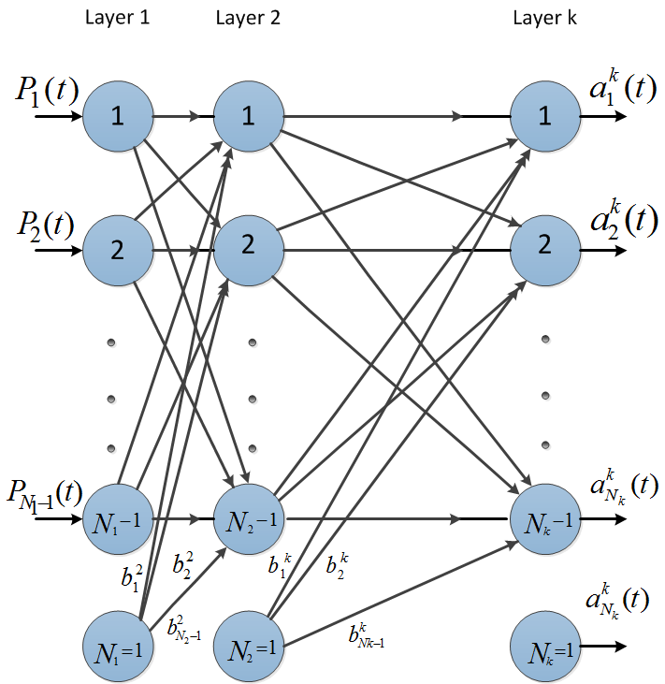


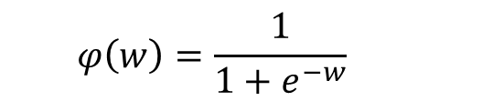
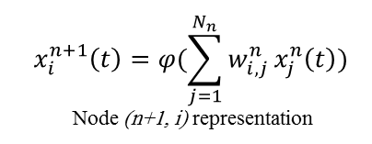
1. ARTIFICIAL NEURAL NETWORKS
$$x_{i}^{n+1}\left(t\right)=φ(\sum_{j=1}^{N_{n}}{w_{i, j}^{n}}x_{j}^{n}\left(t\right))$$
Node (n+1, i) representation
$$\left[\begin{matrix}\begin{matrix}W_{11} & W_{12} \\ W_{21} & W_{22}\end{matrix} & ⋯ & \begin{matrix}W_{1{, N}_{1}} \\ W_{2{, N}_{1}}\end{matrix} \\ ⋮ & ⋱ & ⋮ \\ \begin{matrix}W_{m−1,1} & W_{m−1,2} \\ W_{m,1} & W_{m,2}\end{matrix} & ⋯ & \begin{matrix}W_{m−1{, N}_{1}} \\ W_{m{, N}_{1}}\end{matrix}\end{matrix}\right]$$
Non-Linear Sigmoid Activation function
$$φ\left(w\right)=\frac{1}{1+e^{−w}}$$
m: number of neurons in the hidden layer
$N_{1}$: number of inputs

Slide 6

2. LOGISTIC REGRESSION CLASSIFIER
Linear regression is used to predict outputs on a continuous spectrum.
Example: predicting revenue based on the outside air temperature.
Logistic regression is used to predict binary outputs with two possible values labeled "0" or "1"
Logistic model output can be one of two classes: pass/fail, win/lose, healthy/sick
Hours Studying | Pass/Fail
1 | 0
1.5 | 0
2 | 0
3 | 1
3.25 | 0
4 | 1
5 | 1
6 | 1
PASS/FAIL
LINEAR MODEL
HOURS OF STUDYING

Slide 7

2. LOGISTIC REGRESSION CLASSIFIER
Logistic regression algorithm works by implementing a linear equation first with independent predictors to predict a value.
We then need to convert this value into a probability that could range from 0 to 1.
Linear equation:
$y=b_{0}+b_{1}∗x$
Apply Sigmoid function:
$P\left(x\right)= sigmoid \left(y\right)$
$P\left(x\right)=\frac{1}{1+e^{−y}}$
$P\left(x\right)=\frac{1}{1+e^{−(b_{0}+b_{1}∗x)}}$
PASS/FAIL
LOGISTIC REGRESSION MODEL
HOURS OF STUDYING

Slide 8
2. LOGISTIC REGRESSION CLASSIFIER
Now we need to convert from a probability to a class value which is “0” or “1”.
Class 1
LOGISTIC REGRESSION MODEL
PASS/FAIL
0.5
Class 0
THRESHOLD
HOURS OF STUDYING

Slide 9
3. RANDOM FOREST CLASSIFIERS
Decision Trees are supervised Machine Learning technique where the data is split according to a certain condition/parameter.
Let’s assume we want to classify whether a customer could retire or not based on their savings and age.
Random Forest Classifier is a type of ensemble algorithm.
It creates a set of decision trees from randomly selected subset of training set.
It then combines votes from different decision trees to decide the final class of the test object.
TREE #1
TREE #2
TREE #N
Savings>$1M
Savings>$1M
Savings>$1M
Yes
No
Yes
No
Yes
No
Age > 45?
Class #0
Age > 45?
Class #0
Age > 45?
Class #0
Yes
No
Yes
No
Yes
No
Class #1
Class #0
Class #1
Class #0
Class #1
Class #0
OUT = CLASS #1
OUT = CLASS #1
OUT = CLASS #0
MAJORITY VOTE = CLASS #1

Slide 10
CONFUSION MATRIX
TRUE CLASS
+
-
TYPE I ERROR
+
TRUE +
FALSE +
PREDICTIONS
FALSE -
TRUE -
-
TYPE II ERROR

Slide 11
CLASSIFICATION MODEL KPIs
A confusion matrix is used to describe the performance of a classiﬁcation model:
True positives (TP): cases when classiﬁer predicted TRUE (they have the disease), and correct class was TRUE (patient has disease).
True negatives (TN): cases when model predicted FALSE (no disease), and correct class was FALSE (patient do not have disease).
False positives (FP) (Type I error): classiﬁer predicted TRUE, but correct class was FALSE (patient did not have disease).
False negatives (FN) (Type II error): classiﬁer predicted FALSE (patient do not have disease), but they actually do have the disease
Classiﬁcation Accuracy = (TP+TN) / (TP + TN + FP + FN)
Precision = TP/Total TRUE Predictions = TP/ (TP+FP) (When model predicted TRUE class, how often was it right?)
Recall = TP/ Actual TRUE = TP/ (TP+FN) (when the class was actually TRUE, how often did the classiﬁer get it right?)

Slide 12
FACTS:
100 PATIENTS TOTAL
91 PATIENTS ARE HEALTHY
9 PATIENTS HAVE CANCER
PRECISION VS. RECALL
TRUE CLASS
Accuracy is generally misleading and is not enough to assess the performance of a classifier.
Recall is an important KPI in situations where:
Dataset is highly imbalanced; cases when you have small cancer patients compared to healthy ones.
+
-
TP = 1
FP = 1
+
PREDICTIONS
-
FN = 8
TN = 90
Classiﬁcation Accuracy = (TP+TN) / (TP + TN + FP + FN) = 91%
Precision = TP/Total TRUE Predictions = TP/ (TP+FP) = ½=50%
Recall = TP/ Actual TRUE = TP/ (TP+FN) = 1/9 = 11%

Slide 13
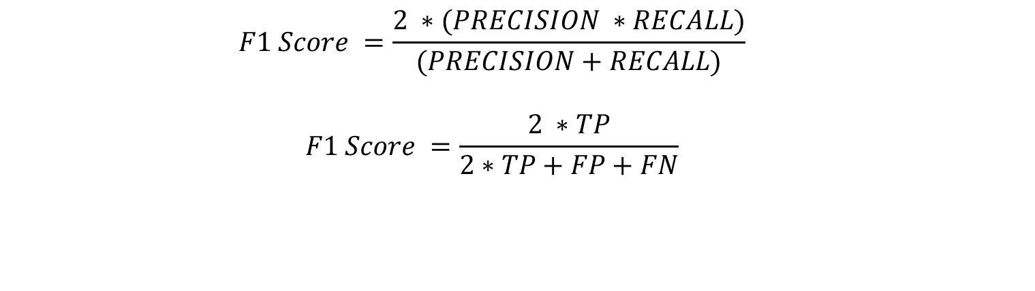
F1-SCORE
$$F1 Score =\frac{2 ∗(PRECISION ∗RECALL)}{(PRECISION+RECALL)}$$
$$F1 Score =\frac{2 ∗TP}{2∗TP+FP+FN}$$
F1 Score is an overall measure of a model's accuracy that combines precision and recall.
F1 score is the harmonic mean of precision and recall.
What is the difference between F1 Score and Accuracy?
In unbalanced datasets, if we have large number of true negatives (healthy patients), accuracy could be misleading. Therefore, F1 score might be a better KPI to use since it provides a balance between recall and precision in the presence of unbalanced datasets.

